Slide 1
Project Title: Balancee Rewards Feature

Slide 2
SHORT INTRODUCTION
I am Wilfrid Okorie, a self-taught Frontend Web Developer
I am on Github as OWK50GA
I am a HNG 11 intern, and had to quit after it clashed with school exams
I seek to grab the opportunity offered for this project.
NOW, TO THE PROJECT

Slide 3
Task Objective Summary
Creating a Rewards Summary feature for Balancee customer platform that does three things: Gives a summary of earnings, show earning history and gives customers opportunity to claim earnings either by bank withdrawal or by converting to some Promo Code.

Slide 4
Technologies Used:
React
TypeScript
Tailwind
Other libraries such as:
React Router DOM
React Icons
React Hook Forms/Zod
React-Toastify

Slide 5
Project Resources/Details for Reference
Prototype Link
Github Repository Link
Figma Design Link
Resume Link

Slide 6
PROJECT OVERVIEW

Slide 7
BASIC LAYOUT
The basic layout of the project is the same basic layout of the Balancee Platform replicated.
However, since it was the Rewards Summary Feature that was required, other pages all lead to the same view.
The sidebar is present, and tweaked an unnoticeable bit, as my suggestion of the better way it can look, though both ways are Ok.
The Rewards Summary route is added to the NavLinks displayed in the sidebar. When it is active, it gives birth (on the sidebar) to three child routes, the Earnings Overview route, the Cashback History route and the Cashout Rewards Route.
Some header functions are excluded due to not being relevant here, such as the search bar.

Slide 8
DESIGN PRINCIPLE
The sticks as much as possible to the design system of the Balancee Platform. It maintains the principle theme of blue and white, as is even done in this presentation.
The three routes created stick very highly to this theme, and apply the theme appropriately i.e. only when necessary, to ensure the styling of the site is simple and user-friendly.
User interactivity with buttons, forms and other elements is added in terms of subtle animations, hover features, et cetera.

Slide 9
UI DETAILS

Slide 10
ROUTE 1 – EARNINGS OVERVIEW
This is the index route in the Rewards Summary Page, and it shows three variables:
The Total Cashbacks Earned
The Current Cashback balance
The number of transactions completed
It has a simple UI majorly blue-themed, and user interaction elements such as hover on buttons. It also has a bit of animation to it.

Slide 11
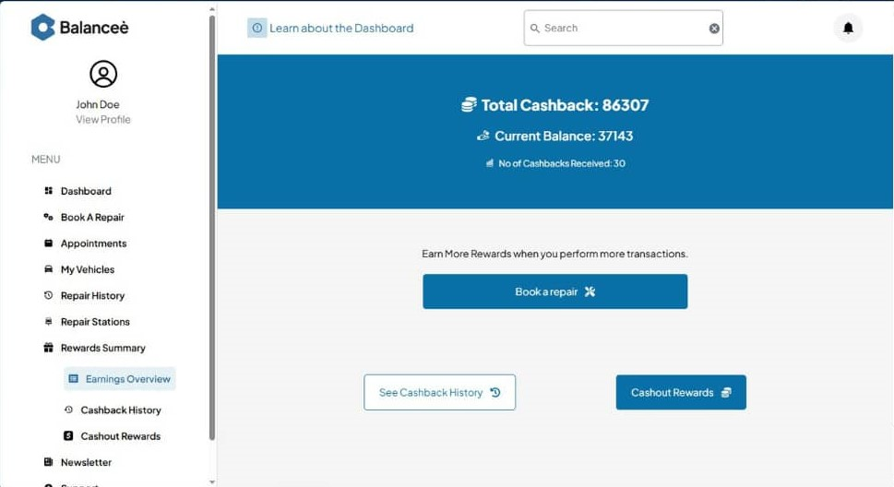

Slide 12
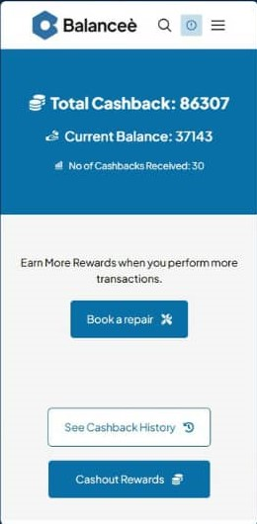

Slide 13
ROUTE 2 – CASHBACK HISTORY
This is the first actual child route, since the overview displays automatically when the route, ‘/dashboard/rewards-summary’ is active.
It is also majorly themed blue, and shows the Cashback Details on a table. Just like the Earnings Overview, it shows a button to the next route, but only to cashout current balance. It also applies gradient and animation.
The Cashback history table when mobile scrolls on its div without breaking the entire layout. It has a tag in a column that shows whether that cashback has been consumed as well, shown as Cashback Status.
It also has Sort and Filter features which enables users sort by date, amount earned and (transaction cost).
Lastly, it has pagination, which enables it contain 10 cashbacks per page.

Slide 14
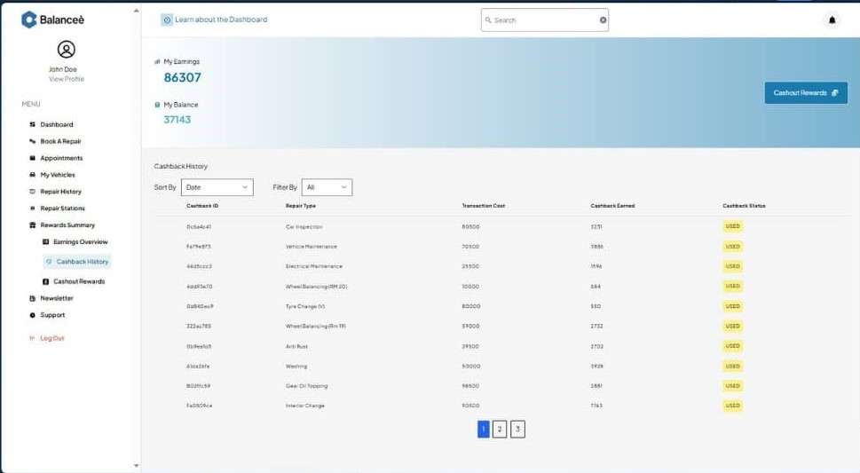

Slide 15
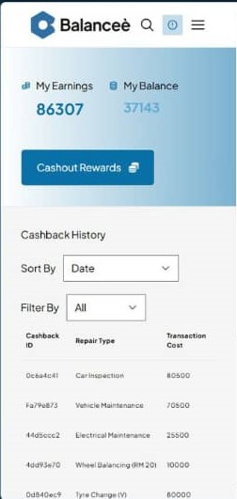

Slide 16
ROUTE 3 – CASHOUT REWARDS
This is the second child route of the rewards summary (the earnings overview is not considered a child route).
This route contains a select field to choose cashout mode. The default mode is direct cashout. The other is using the cashbacks to purchase a promo code.
When the user picks direct cashout, they can choose to withdraw it to bank or add to future bookings. However, this direct cashout only allows the user 80% of their rewards, so that some users willing to risk it will go for the second.
If they choose to go for a promo code, they might get high or low rewards. The promo codes can redeem free services such as free vehicle maintenance.
Both options have separate forms which are properly validated with user interactivity.

Slide 17
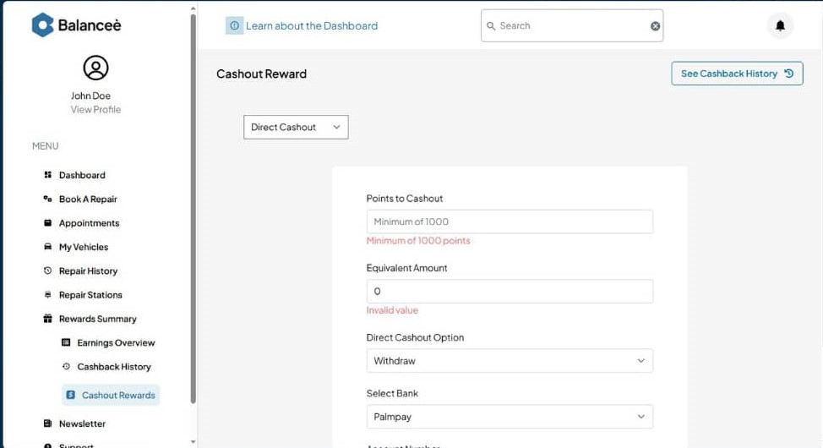

Slide 18
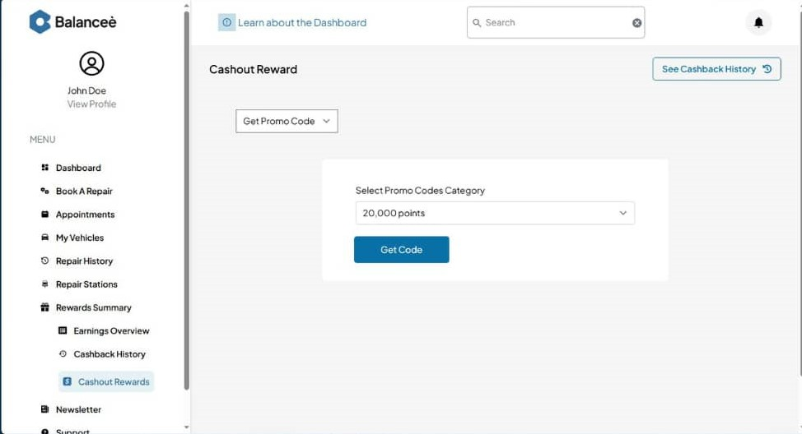

Slide 19
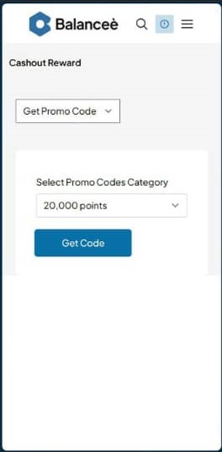

Slide 20
SECTION CONCLUSION
The UI, UX and business decisions I made to come up with the following is from a blend of the instructions given and my own ideas for a business.
I am sure if I am hired for the role, I can reflect your intentions better.

Slide 21
TECHNICAL (PROGRAM) DETAILS

Slide 22
OVERVIEW
The project was written using React + TypeScript, with Vite as the Development Server, Build tool, and other functions it serves.
The project uses Tailwind CSS for its styling
Other libraries were installed:
React Router DOM handles the routing
Zod and React Hook Forms handle form validation
React Toastify handles the toast notifications on actions
React Icons provides the icons used in the project.
These are the most important libraries that were used.

Slide 23
LAYOUT AND ROUTING
React Router handles the layout and routing, as stated. There is a RootLayout component that defines the layout for the dashboard and serves as the platform on which every other thing is rendered. It also guides the rendering of the sidebar when the project is in views less than 1024px.
The React Router is used to create Routes From Elements in the App.tsx file, and the whole App is wrapped by the RouterProvider.

Slide 24
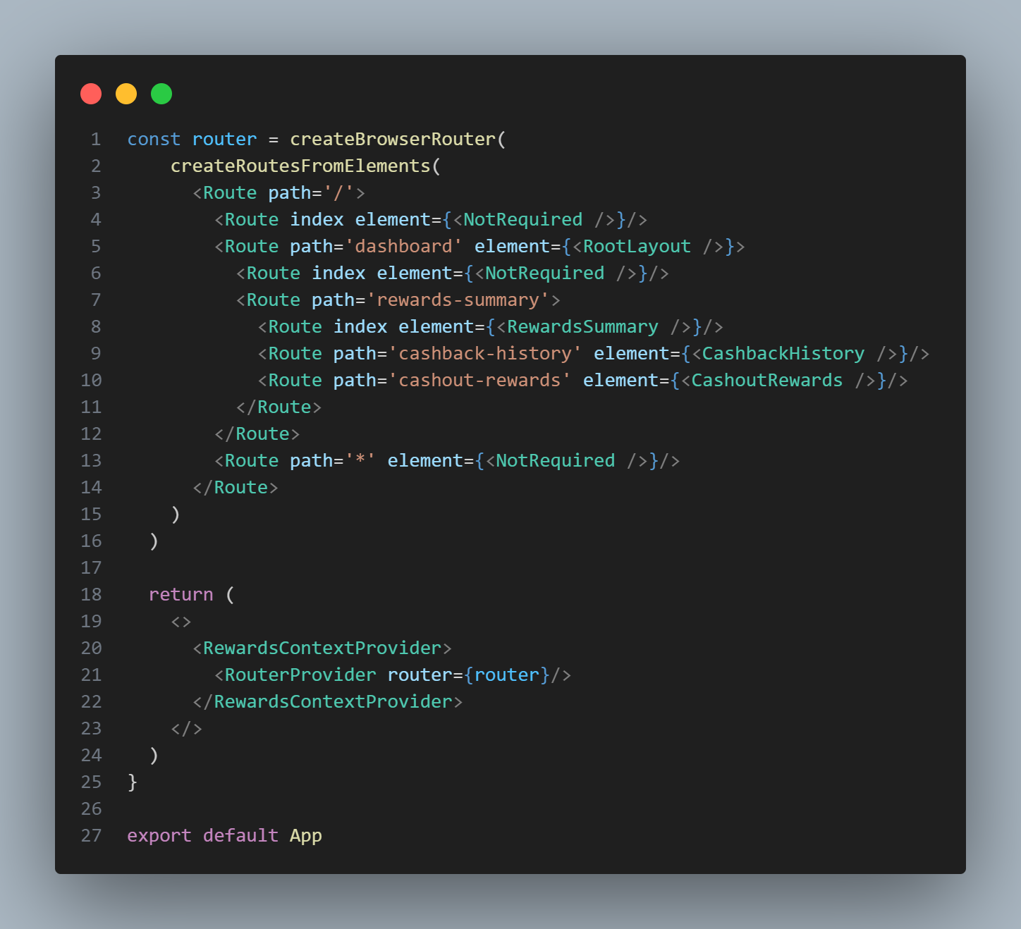

Slide 25
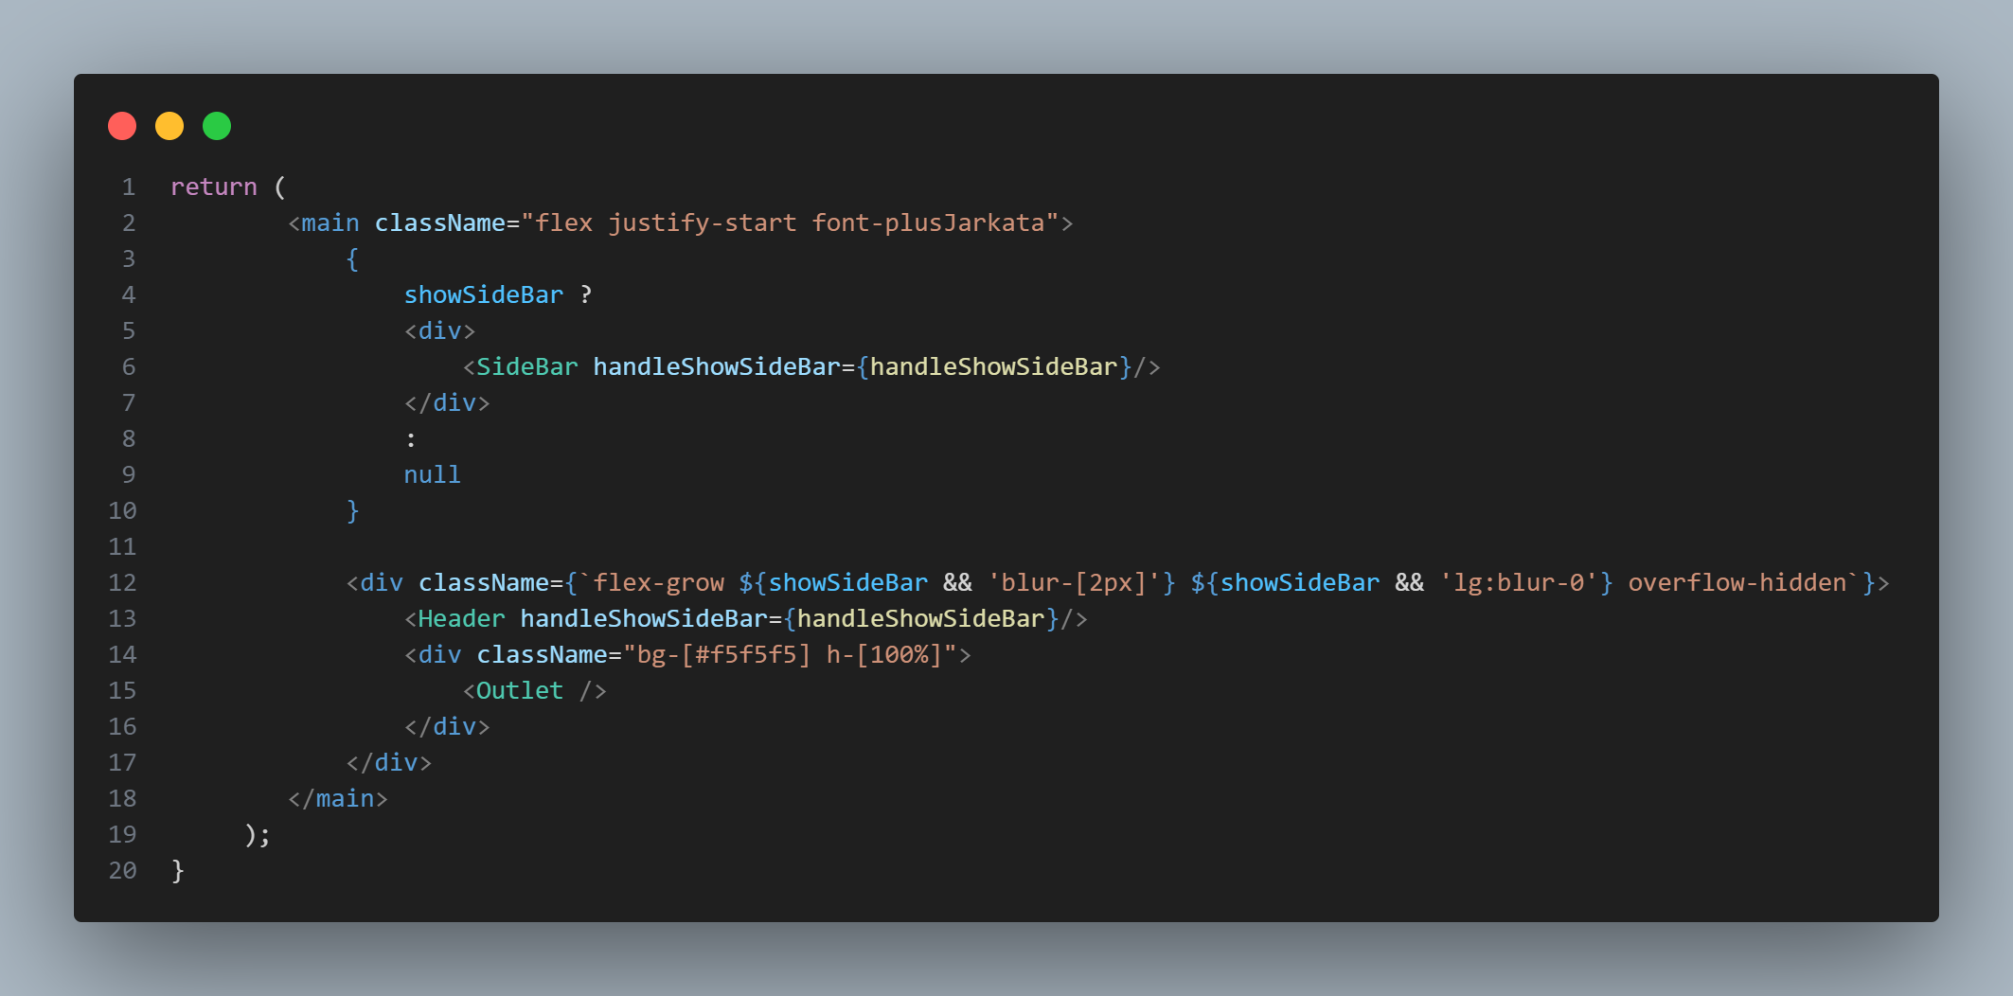

Slide 26
Data Fetching and Data State Management
The useContext React hook is used in a file called the RewardsContext, in the context folder in the src folder.
In this file, the data is fetched using the Fetch API. Two major pieces of data: the Earnings Overview and the Cashback History. These two are placed/set as context. The functions to edit any of them are also defined in this context, and the context provider is used to wrap the App also, so that the data can be effectively shared to all the components that would need it.
There is a lot of chaining done as regards the context, so that one does not need to directly change something that would have a ripple effect. One only needs access to the tip in different cases.

Slide 27
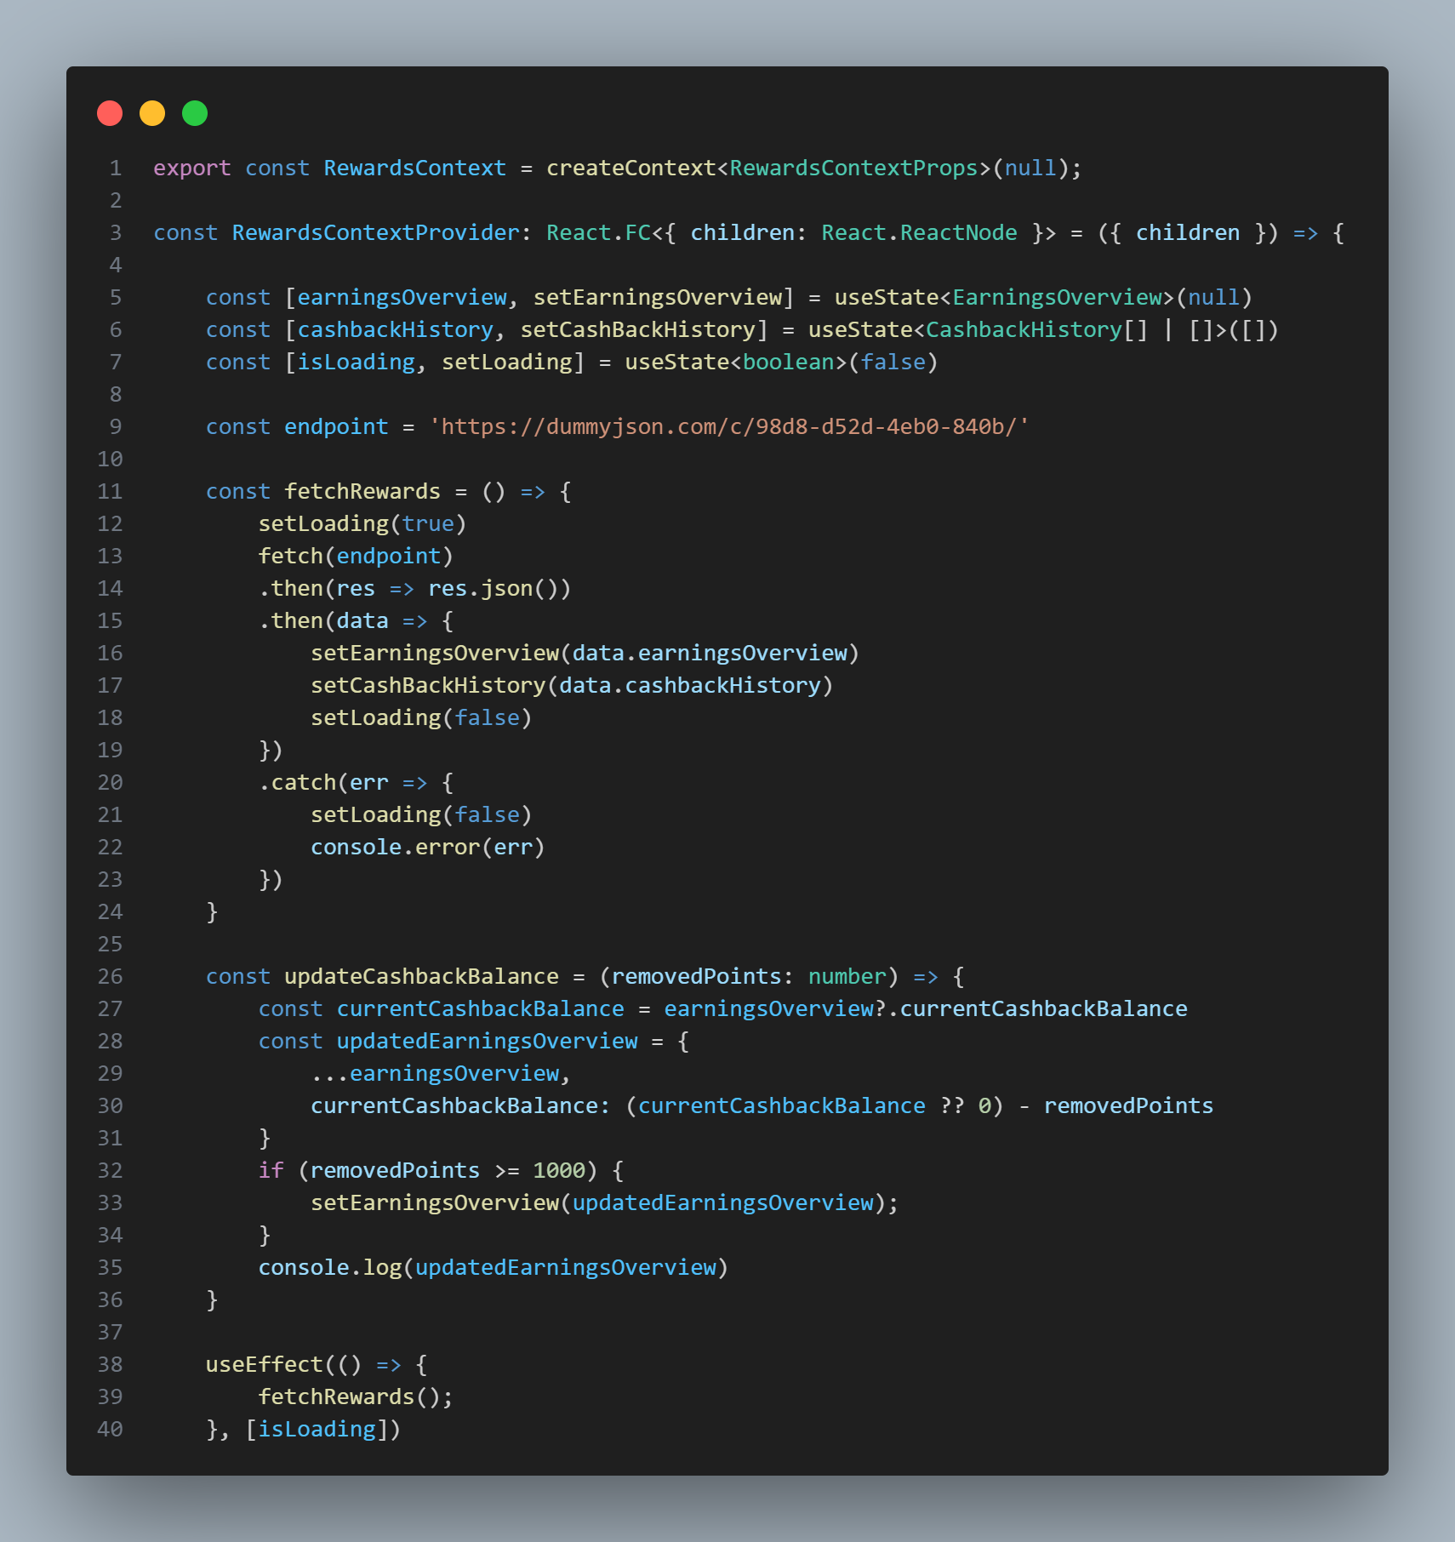

Slide 28
Earnings Overview Page
The Earnings Overview page is a simple page which just consumes one piece of context: the earningsOverview object. It displays the total rewards earned and the current cashback balance, as well as the number of transactions done.
It contains Links in the other section which lead to different pages, mainly the cashback-history page and the cashout-rewards page.

Slide 29
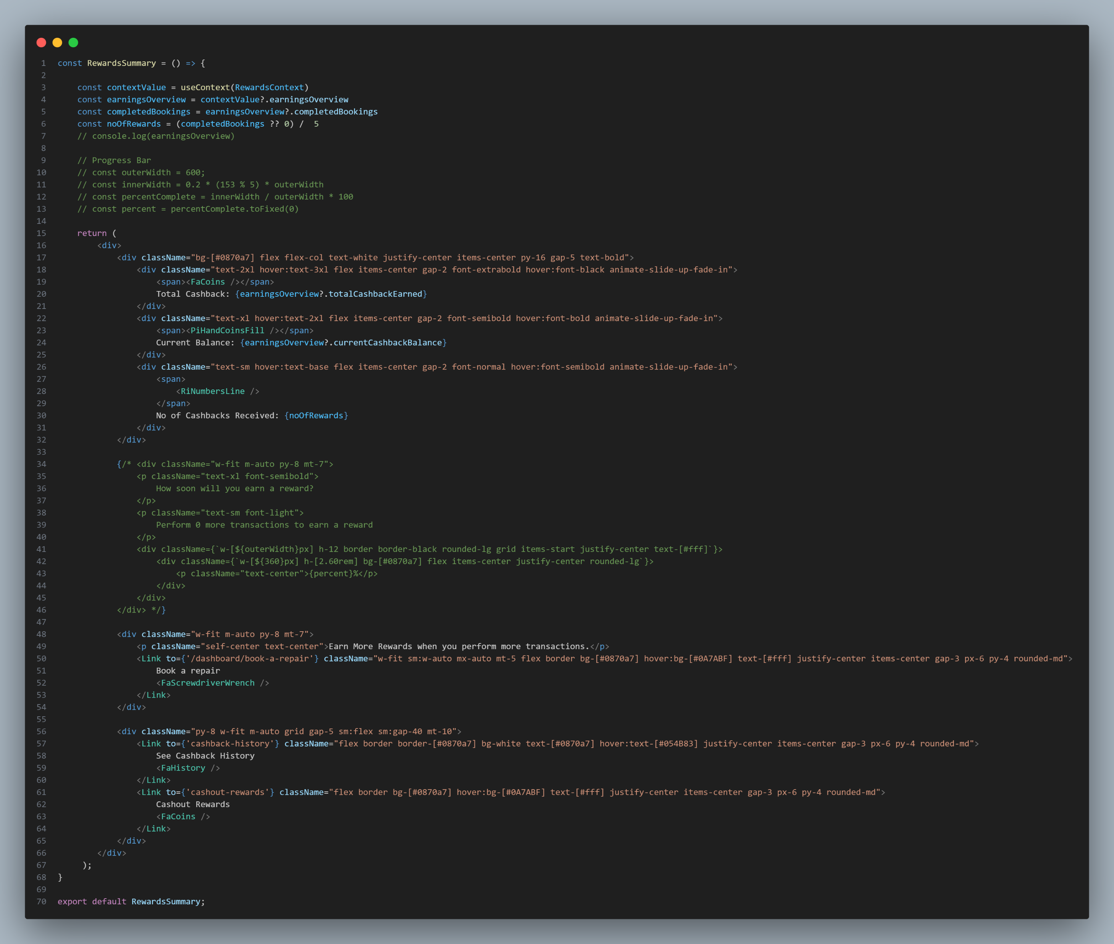

Slide 30
Cashback History Page
This is the second most complex page in the document.
It consumes the cashback history in the form of context from the RewardsContext.tsx. It then initializes a state called displayedCashbackHistory to avoid editing the cashback history directly.
It contains code for filtering and sorting the data based on different criteria.
The displayedCashbackHistory is displayed using table, by means of mapping of the array, given that the cashback history is an array of objects.
It contains pagination at the bottom that uses variables, not hard-coded data to ensure its correctness at each point.
Most of the variables in this page use states, so that they update when necessary.

Slide 31
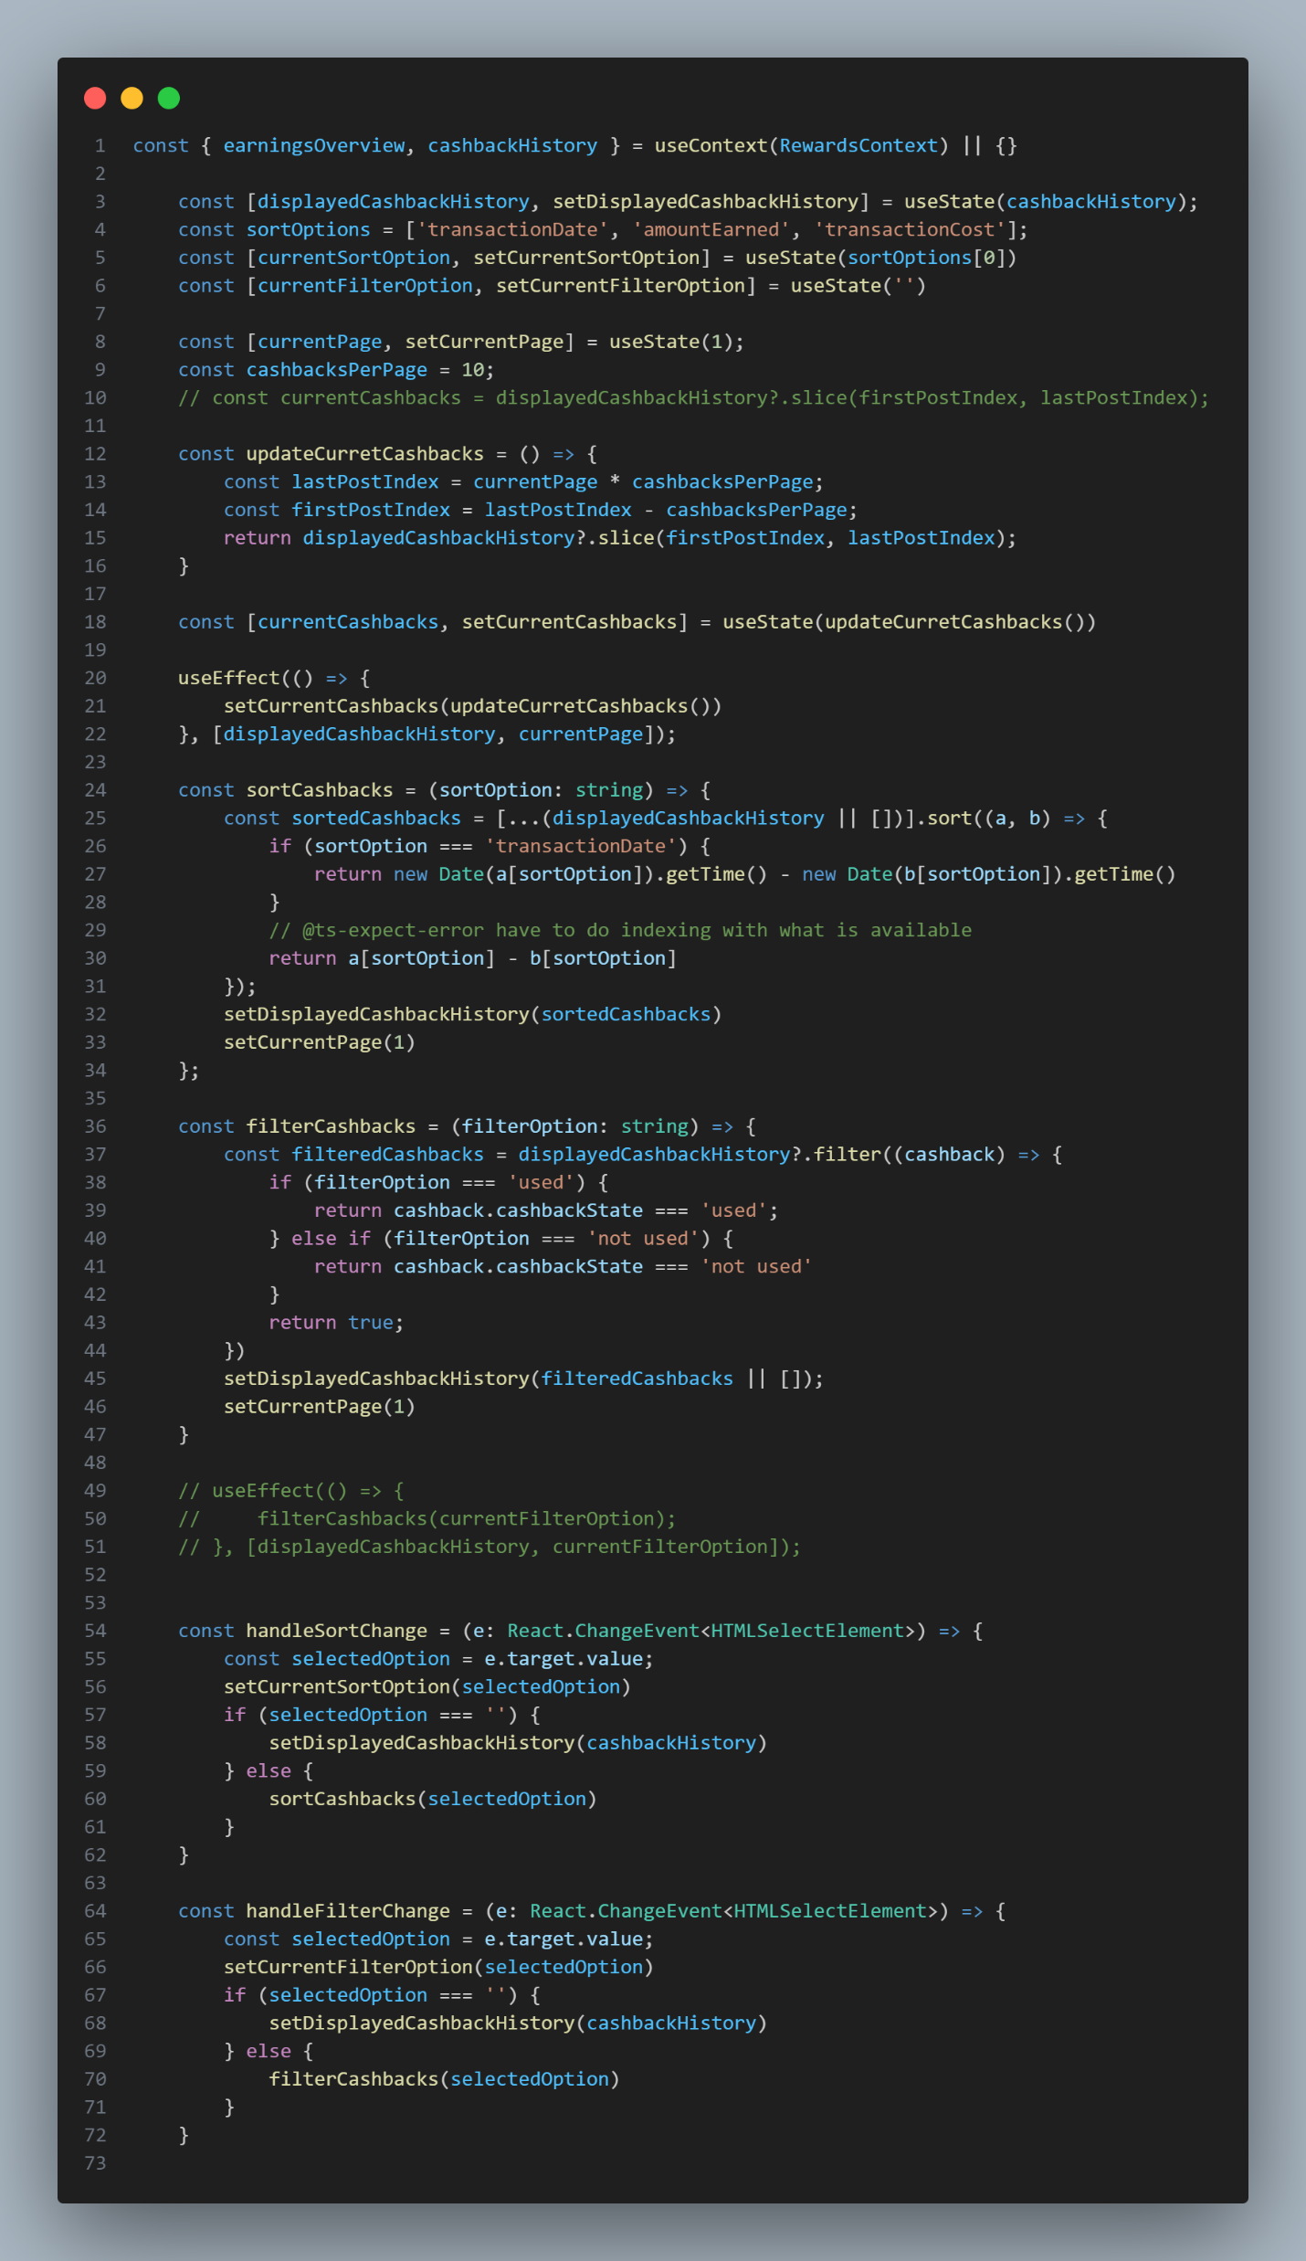

Slide 32
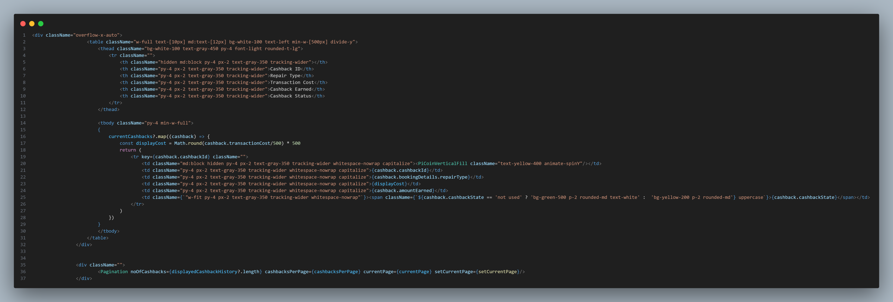

Slide 33
Cashout Rewards Page
This page has a select field at the top, which determines which form to render. The options are Direct Cashout and Promo Code, and their purposes were explained earlier in the presentation.
The project uses Zod and React Hook Forms, which are both TypeScript-first built, and are very strict and ideal for validation of such forms.
The validation schema for the Direct Cashout is complicated, since the form has two options in itself, Withdrawal and Adding to Future Bookings (as discount).

Slide 34
Cashout Rewards Page – Part 2
It has a field where the user picks the amount (the project used a point system since it is mostly not direct conversion to currency) he wants to redeem.
The Zod validation covers for all the cases.
After the form is submitted, the user is redirected to the rewards-summary page, its parent route. Working with your company, that redirection would be to the dashboard itself. A toast is also used to notify the user of success or failure of the process. The only failure case accounted for here is a case where the user tries to redeem more points than he has. Working with your company, I am sure I would be able to reflect the company’s visions better in these areas.

Slide 35
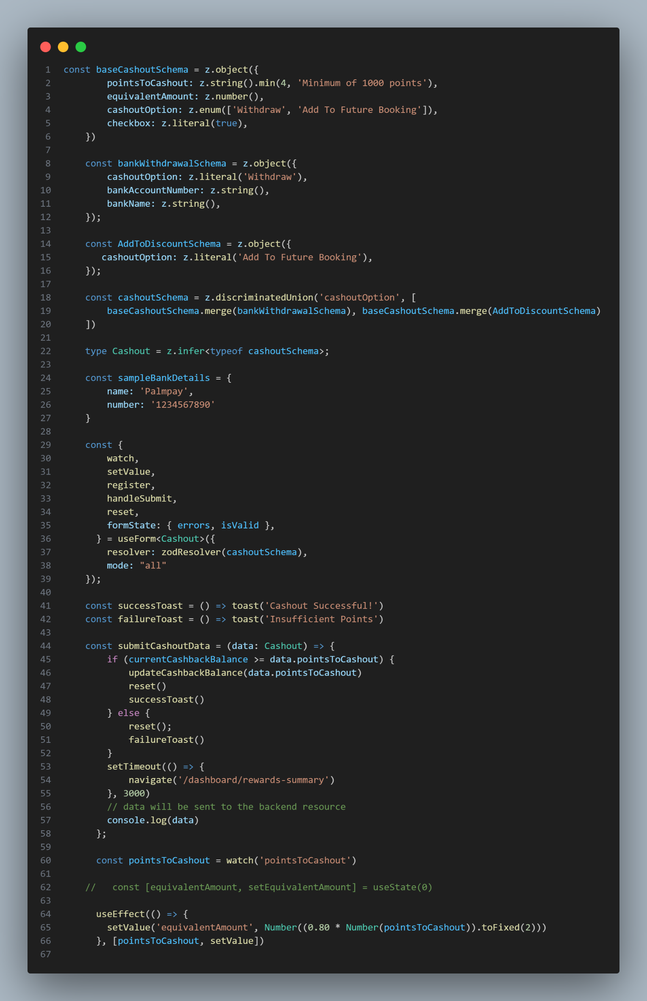

Slide 36
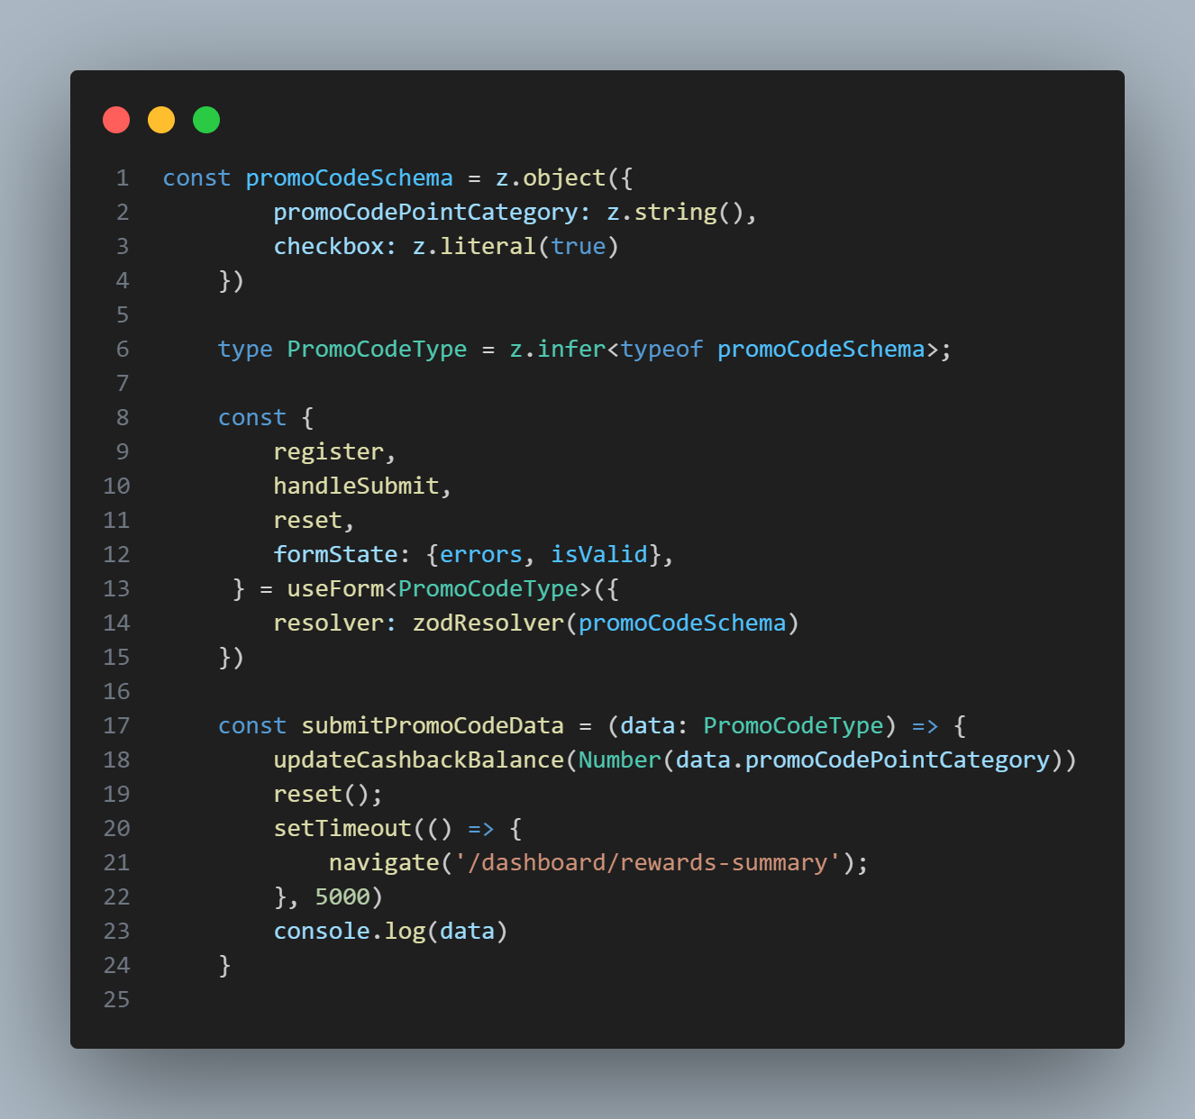

Slide 37
The code was made sure to be completely error-free.
The TypeScript errors were solved using different principles as appropriate such as:
Null Coalescing
Optional Chaining
Type Guard
Fall back value
… and so on.

Slide 38
Other Things I Know Could Have Been Implemented:
Notification Modal
More sort and filter conditions
Generation of the promo code or fetching from an endpoint, and supplying to the customer’s account using the notification modal.
However, these were excluded for Brevity and lack of resources to an extent. I could do them if this were the official feature, or if I was hired.

Slide 39
The entire code can be found in the github repository submitted, or directly in {Repo}

Slide 40
CONCLUSION

Slide 41
In the end, the project was ensured to be made as maintainable as possible, and uses strict typing with resources like eslint to ensure minimization of errors.
I believe this is ideal for the company, and these ideas of mine will come good.
Lastly, I would be better able to reflect the company’s goals in my code after being hired.

Slide 42
THANK YOU

